Slide 1


QUIZ GAME
SUBMITTED BY :
ANUSHKA GUPTA(2100290110033)
ASTHA GUPTA(2100290110038)
ISHAN SHARMA(2100290110065)

Slide 2

WHAT IS QUIZ GAME???
QUIZ is a game or competition in which you have to answer questions.
These questions are based on data structure.
There are multiple players in this game who can compete
With each other, by choosing more correct answers.

Slide 3
SYNOPSIS
This system is helpful for conducting (M.C.) Multiple Choice Examinations which can be conducted and provides immediate results saving the precious time of checking and prepare mark examinations.
PROGRAMMING LANGUAGE USED: C++
IDLE: DEV C++

Slide 4
DATA STRUCTURE IMPLEMENTATIONS:
LINKEDLIST - a linked list consists of nodes where each node contains a data field and a reference(link) to the next node in the list.
VECTOR - Vectors in C++ are sequence containers representing arrays that can change their size during runtime.
SORTING - Sorting is the process of arranging elements either in ascending (or) descending order.

Slide 5
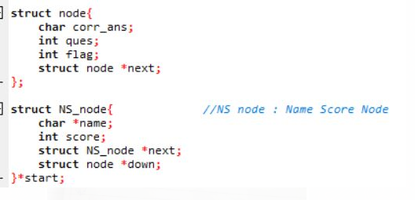
MAKE TWO NODES
STRUCT NODE
1. It require correct answers.
2.Questions
3.Flag pointer
4.Next node connect
NAME SCORE NODE
Name of a person who attempt quiz
Score
Next node pointe
Down pointer

Slide 6
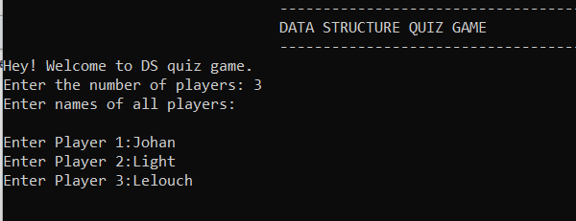
INPUT DETAILS
Number of Players and name of each player is taken as an input,

Slide 7
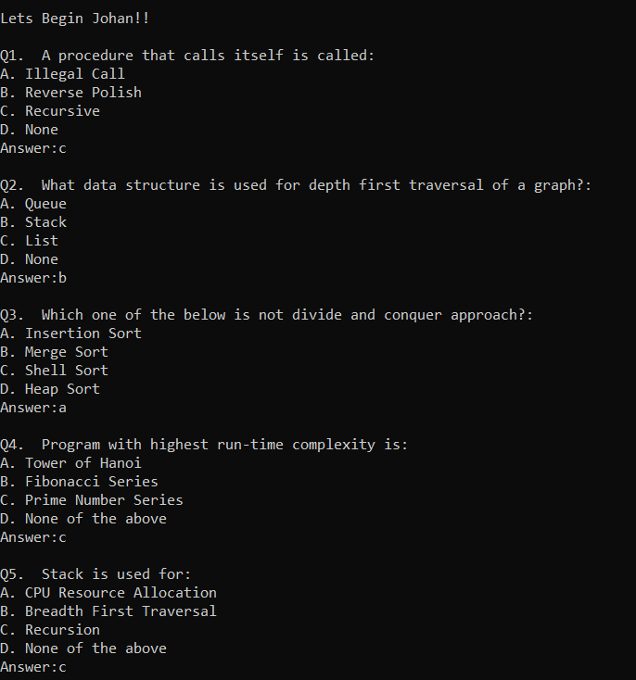
QUESTIONS:
A set of 5 questions is asked from every player and total score of each player is stored in Nodes.

Slide 8
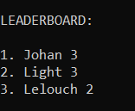
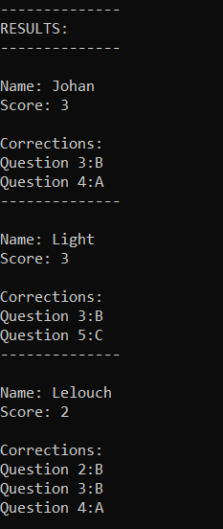
RESULT CARD LEADERBOARD
The Result Card of each
student is showed,
Along with the correction
To their wrong answer.
Names and scores are structured in a Vector Pair, and then are sorted to display the Leaderboard.

Slide 9
LINKELIST REPRESENTATION USING DIAGRAM

Slide 10

NS NODE
RAM 3 X
NAME SCORE DOWN NEXT
1 0 A
QUES NO. FLAG(0/1) ANSWER NEXT
NODE
2 1 X X
QUES NO. FLAG(0/1) ANSWER NEXT

Slide 11
REFERENCES:
https://www.geeksforgeeks.org/sort-vector-of-pairs-in-ascending-order-in-c/
https://www.youtube.com/watch?v=FY1LEPhfW2c
GitHub Link:
https://github.com/IshanSharma137/QuizGameDS

Slide 12


